Slide 1
Accessing files and data through networks
InputStream and OutputStream

Slide 2
Practical information
We have one assignment which will be graded at the end of the course, upon submission
After each lesson, you will be able to implement a part of the assignment
We recommend to do it gradually
At the beginning of each lesson, we will do a "refresher" of the previous topic. Come with a smartphone
Each lesson includes some practice. Be here with a laptop and enough battery
Tooling:
VS Code or IntelliJ Idea
Java 21
Git
Setup everything by using the "cook-books" from oop-2: https://appliedmath.toi.inholland.nl/oop-2-code-projects/cook-books

Slide 3
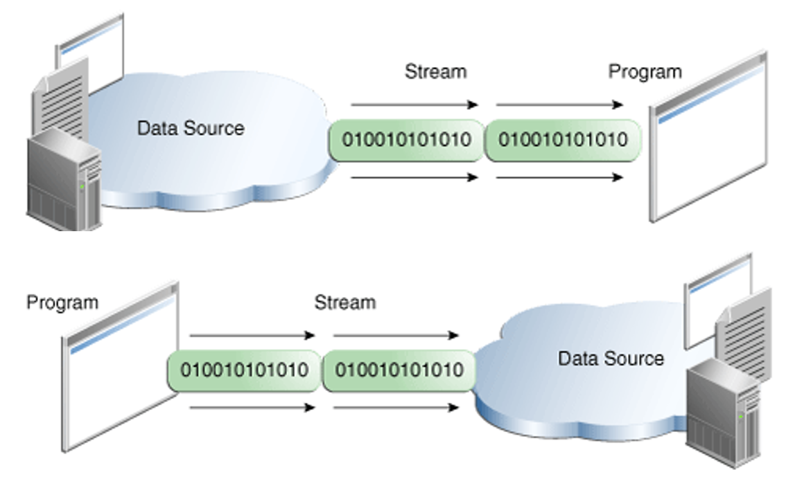
Input streams and output streams (reading and writing)

Slide 4
Base classes for IO (input output)
InputStream – abstract class to read raw data from a source
OutputStream – abstract class to write raw data data to a target
Reader – abstract class to read character streams
Writer – abstract class to write character streams

Slide 5

Byte Streams
FileInputStream and FileOutputStream work at byte level
Used for tight control over the operations

Slide 6
Byte Streams
public class CopyFile {
public static void main(String args[]) throws IOException { InputStream in = null;
OutputStream out = null;
try {
in = new FileInputStream("input.txt");
out = new FileOutputStream("output.txt");
int c;
while ((c = in.read()) != -1) {
out.write(c);
} } finally {
if (in != null) {
in.close();
}
if (out != null) {
out.close();
}
}
}
}
Example on how to use the input stream and the output stream to copy a file

Slide 7
Character Streams
InputStreamReader and OutputStreamWriter form the bridge between byte streams and characters
InputStreamReader reads and decodes the bytes according to the specified charset
OutputStreamWriter encodes and writes the bytes according to the specified charset
Internally using FileInputStream and FileOutputStream

Slide 8

Character Streams
Text nowadays usually is encoded in 16 bits Unicode
FileReader and FileWriter work on Unicode files
Internally using FileInputStream and FileOutputStream

Slide 9
Standard Streams
System.in – The default input device (usually the keyboard)
System.out – The default output device (usually the monitor)
System.err – The default output device for error messages (usually the same as System.out)
Example:
InputStreamReader in = new InputStreamReader(System.in);

Slide 10
Standard Streams
public class ReadConsole {
public static void main(String args[]) throws IOException {
try (Reader reader = new InputStreamReader(System.in)) {
System.out.println("Enter characters, 'q' to quit.");
char c;
do {
c = (char) reader.read();
System.out.print(c);
} while (c != 'q');
}
}
}
Examples of the standard input and output

Slide 11
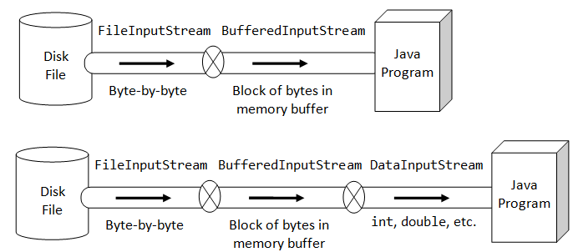
Buffered IO

Slide 12
Buffered IO
public class ReadConsole {
public static void main(String args[]) throws IOException {
BufferedReader reader = null;
PrintWriter writer = null; try {
reader = new BufferedReader(new FileReader("source.txt"));
writer = new PrintWriter(new FileWriter("output.txt"));
String line;
while ((line = reader.readLine()) != null) {
writer.println(line);
}
} finally {
if (reader != null) {
reader.close();
}
if (writer != null) {
writer.close();
}
}
}
}
Using buffering enables to read the entire line and print it out

Slide 13
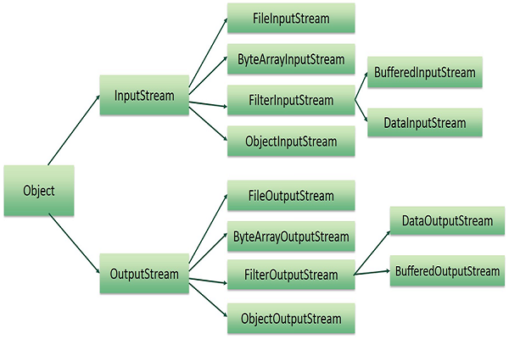

Slide 14
The File and Path classes
File is an abstract representation of file and directory pathnames.
Gives methods to manipulate files and directories
Filenames are platform-specific
Two static fields to get the platform-specific path and name seperators
Use the toPath() method to get a Path object
Path is a newer class (in the nio package instead of the io package)
Offers different methods than File
Can be iterated over
Use File to manipulate the files and directories or get information on the contents of directories, Path to get information on the item itself

Slide 15

Practice time
Let’s create an application that saves the input from your keyboard to a file

Slide 16
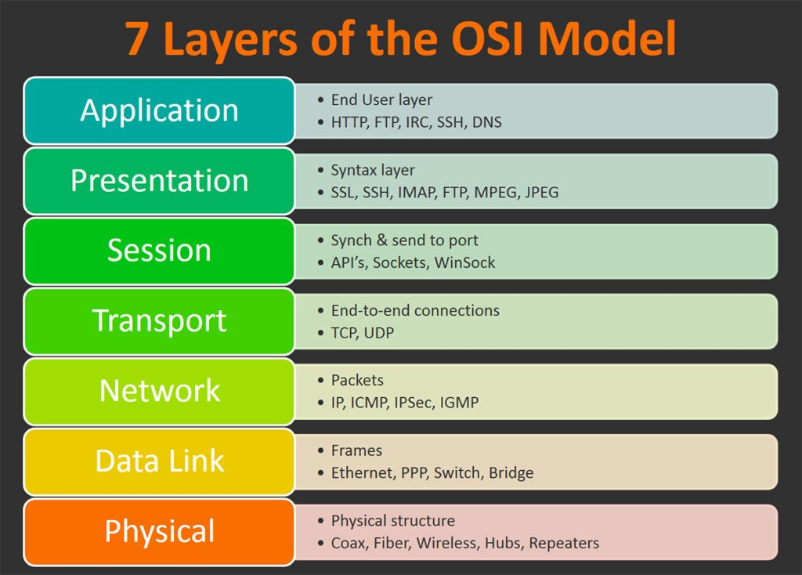
Network model: OSI
Operational Systems Interconnection
Usually, we talk about level 4 and level 7

Slide 17








Network model: OSI
Same application Backup server Level 4
Backup application Level 7

Slide 18
Network protocols
Network layer
Internet Protocol (IP) -> Knows where a computer can be reached.
Transport layer
Transport Control Protocol (TCP) -> Reliable delivery.
User Datagram Protocol (UDP) -> Best effort delivery
Application Layer
HyperText Transfer Protocol (HTTP)

Slide 19



Connecting to a URL
public class ConnectToUrl {
public static void main(String args[]) throws Exception {
try {
URL myURL = new URI("http://example.com/").toURL();
URLConnection myURLConnection = myURL.openConnection();
myURLConnection.connect();
myURLConnection.getInputStream();
} catch (URISyntaxException e) {
// new URL() failed
} catch (IOException e) {
// openConnection() failed
}
}
}
URL and URI are the classes needed to build and represent an internet address.
URLConnection is the class needed to establish the connection
Connecting to a URL
After the connection is established, we can use the input stream to get the data as seen before

Slide 20
Shortcut: reading from a URL
public class ConnectToUrl {
public static void main(String args[]) throws Exception {
URL oracle = URI.create("http://www.oracle.com/").toURL();
BufferedReader in = new BufferedReader(
new InputStreamReader(oracle.openStream()));
String inputLine;
while ((inputLine = in.readLine()) != null){
System.out.println(inputLine);
}
in.close();
}
}
Reading from a URL

Slide 21

Connecting to a URL – get “private” data
public class ConnectToUrl {
public static void main(String args[]) throws Exception {
try {
URL myURL = new URI("http://example.com/").toURL();
URLConnection myURLConnection = myURL.openConnection();
httpURLConnection.setRequestProperty("Authorization",
"Bearer secretApiKey");
myURLConnection.connect();
myURLConnection.getInputStream();
} catch (URISyntaxException e) {
// new URL() failed
} catch (IOException e) {
// openConnection() failed
}
}
}
Connecting to a URL
Some online services require to use some authentication method, for example a secret API key

Slide 22

Practice time
Let’s download an image and store it in our file system using input streams and output streams!

Slide 23
Homework
After each lesson, you get a piece of homework that serves as implementation of the final assignment.
Create a free account on https://developer.themoviedb.org/
Understand how to retrieve data and specifically images from the movie db
https://developer.themoviedb.org/docs/getting-started
https://developer.themoviedb.org/docs/image-basics
https://developer.themoviedb.org/reference/movie-images
Use the URL https://api.themoviedb.org/3/movie/{movie_id}/images to get the filename of the image and the URL https://image.tmdb.org/t/p/w780/{file_path} to download the image. Use the input stream and the output stream to store it in your file system as a file.

